Slide 1


Legal Data Analytics - 2023
The complexity of the French Tax Code
From 1980 to 2023
Les Analystes du CGI
Thomas CHATEL, Jean DEMONCHY, Jules GUELY & Adrien LARSEN

Slide 2

/01
Principle of accessibility
The Conseil Constitutionnel has established a principle of accessibility and intelligibility of the law, which is based on the principle that the law must be accessible to all.
But can we really say that the tax law respects this principle?
In 2020 : 4 amending finance acts.
Context
Les Analystes du CGI

Slide 3

Showing the evolution of the complexity of the French Tax Code ("CGI") from 1980 to the present day
Les Analystes du CGI
Showing the interconnection and the interdependence between the articles
Goal of the work performed
Showing the articles that refer most to other articles
Showing the most “famous” articles
/02

Slide 4

AGENDA
Les Analystes du CGI
STEP 1 : The Legifrance's scraper
STEP 2 : The evolution of the number of referrals since 1980
STEP 3 : Prestige & Network Analysis
STEP 4 : Some extra analysis
/03

Slide 5
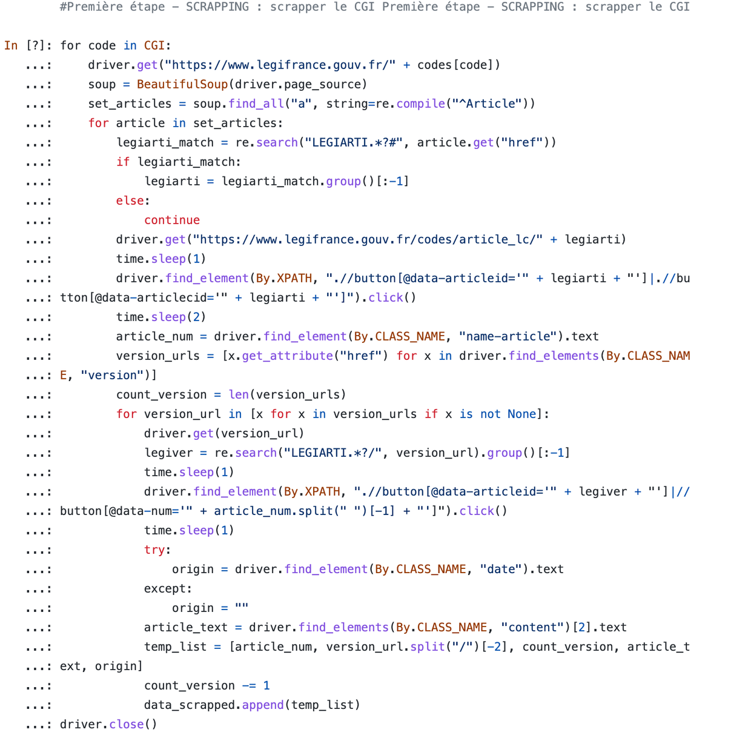
/04
STEP 1 : The Legifrance scrapper
Les Analystes du CGI
The Python Code

Slide 6
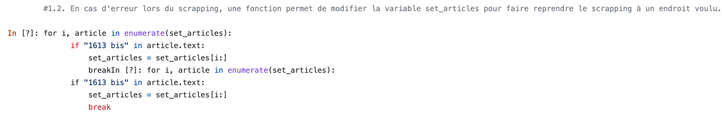
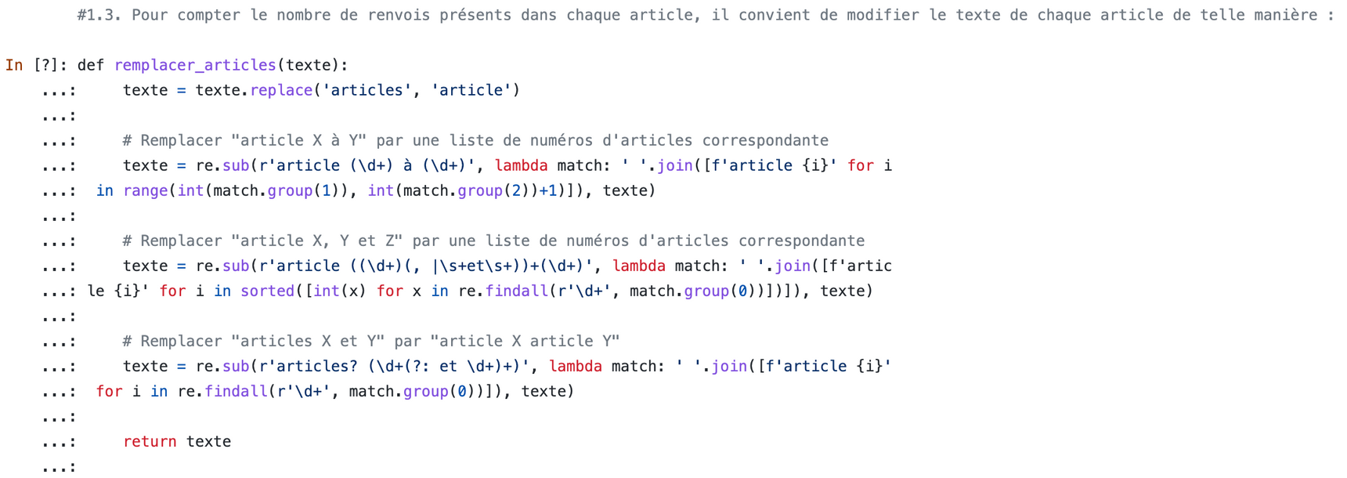
/05
STEP 1 : The Legifrance scrapper
Les Analystes du CGI
The Python Code

Slide 7
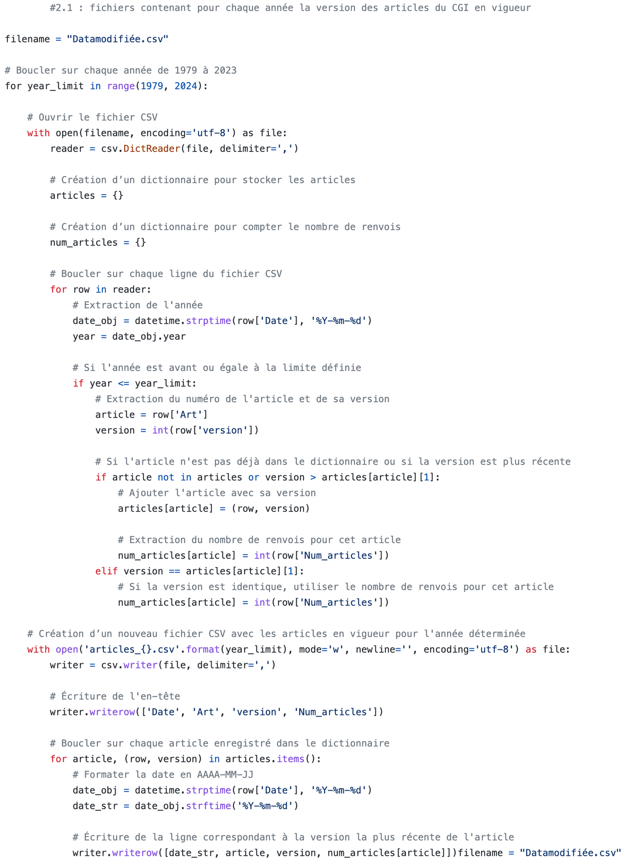
/06
STEP 2 : The evolution of the number of referrals since 1980
Les Analystes du CGI
The Python Code

Slide 8
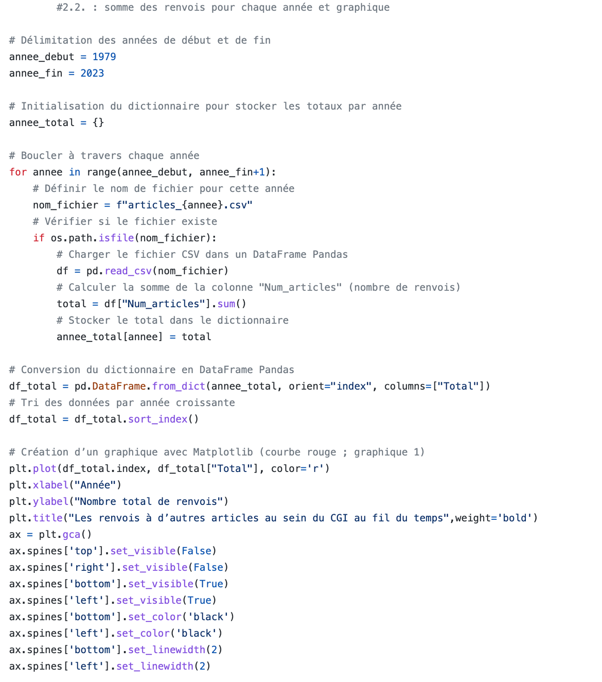
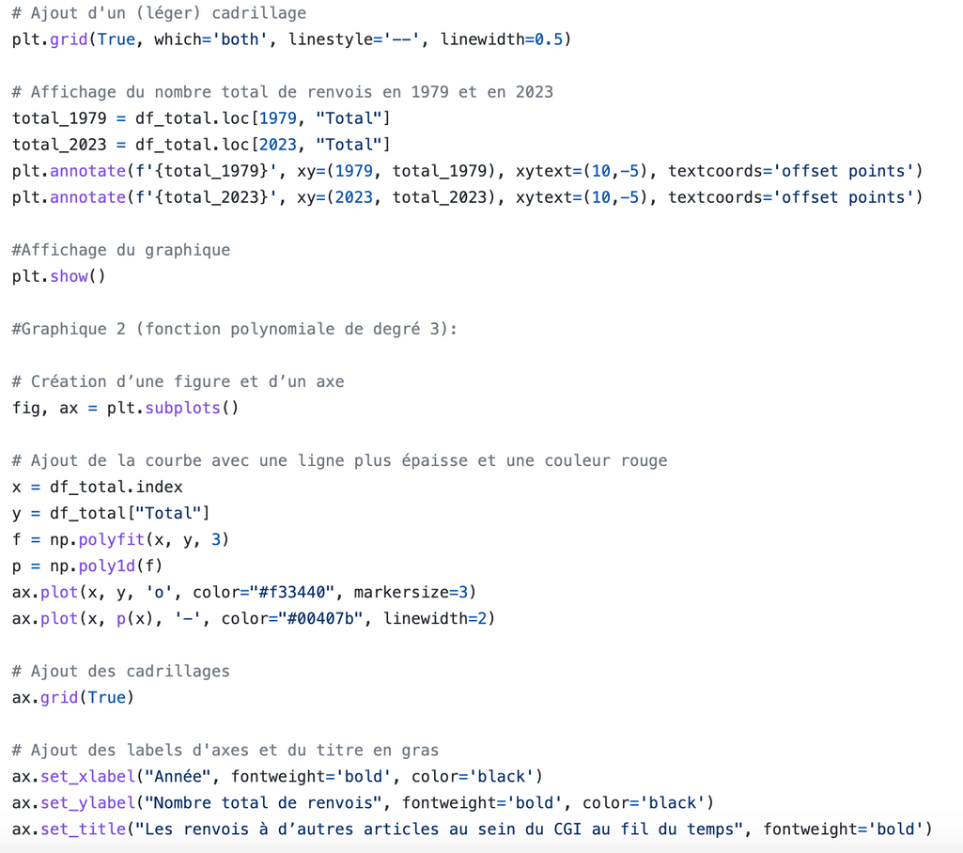
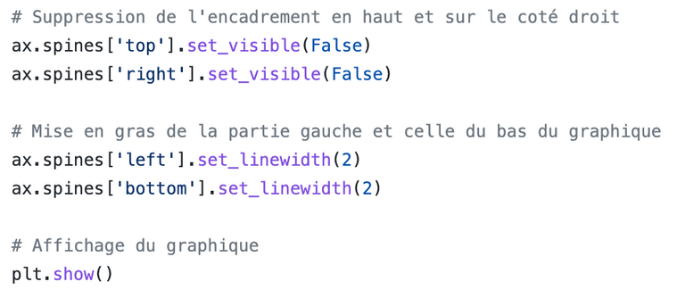
/07
STEP 2 : The evolution of the number of referrals since 1980
Les Analystes du CGI
The Python Code

Slide 9
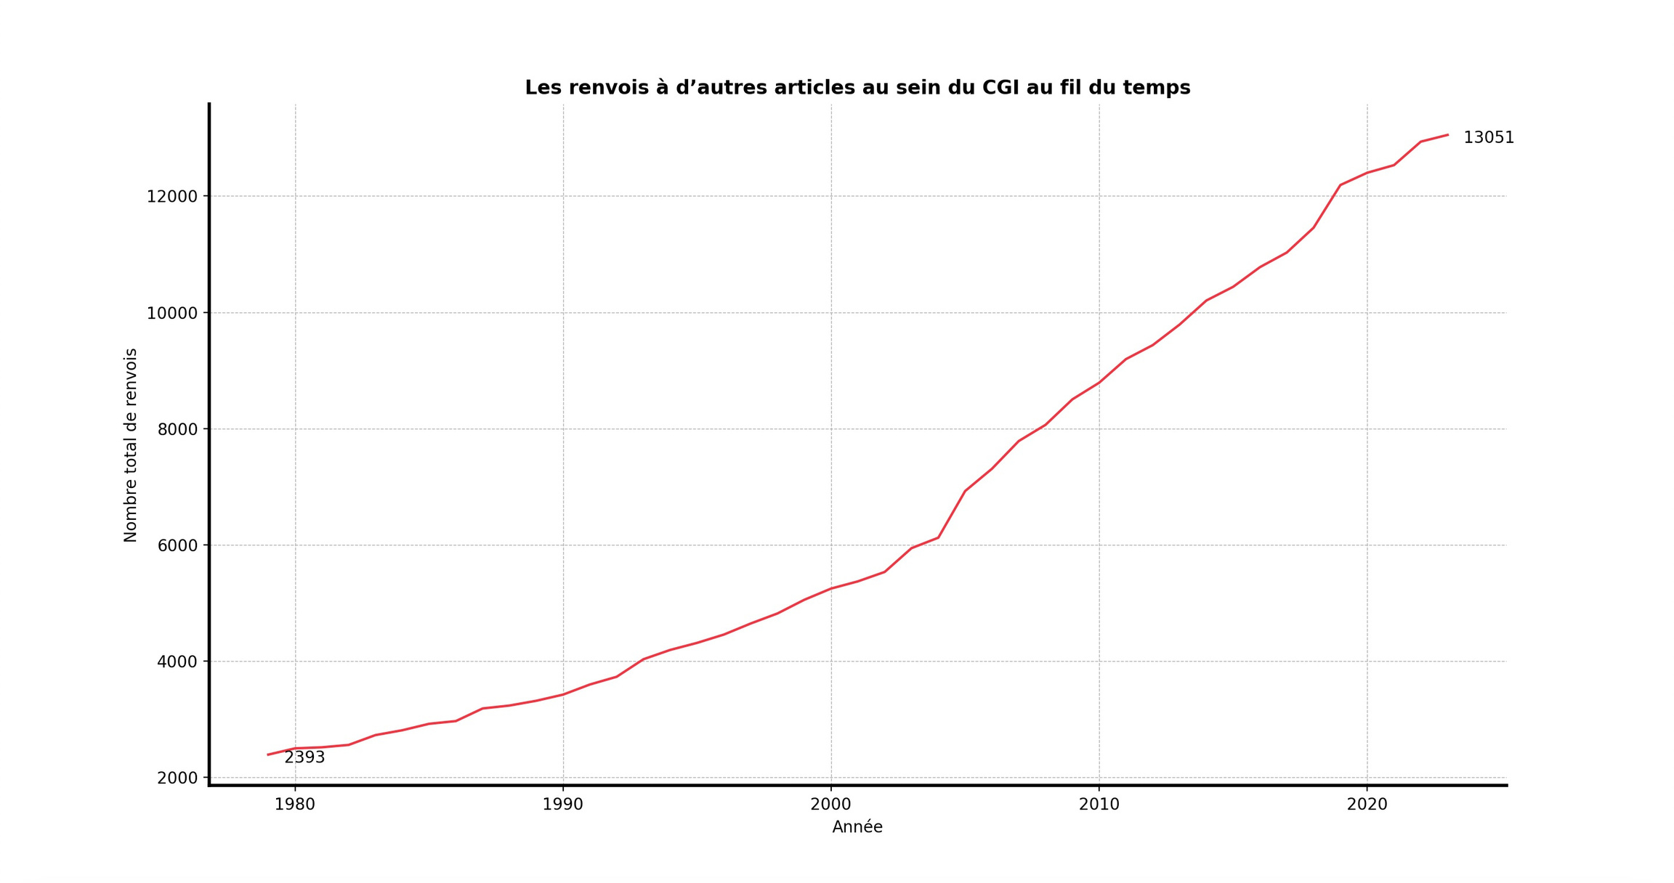
/08
Number of inter-article references in the CGI over time

Slide 10
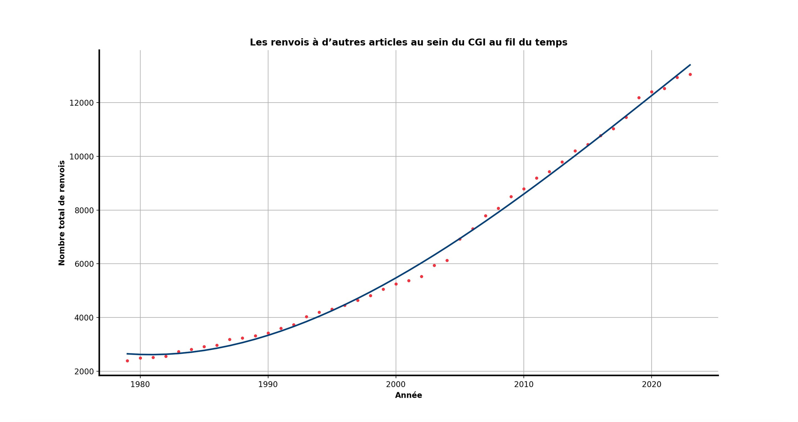
/09
Number of inter-article references in the CGI over time

Slide 11
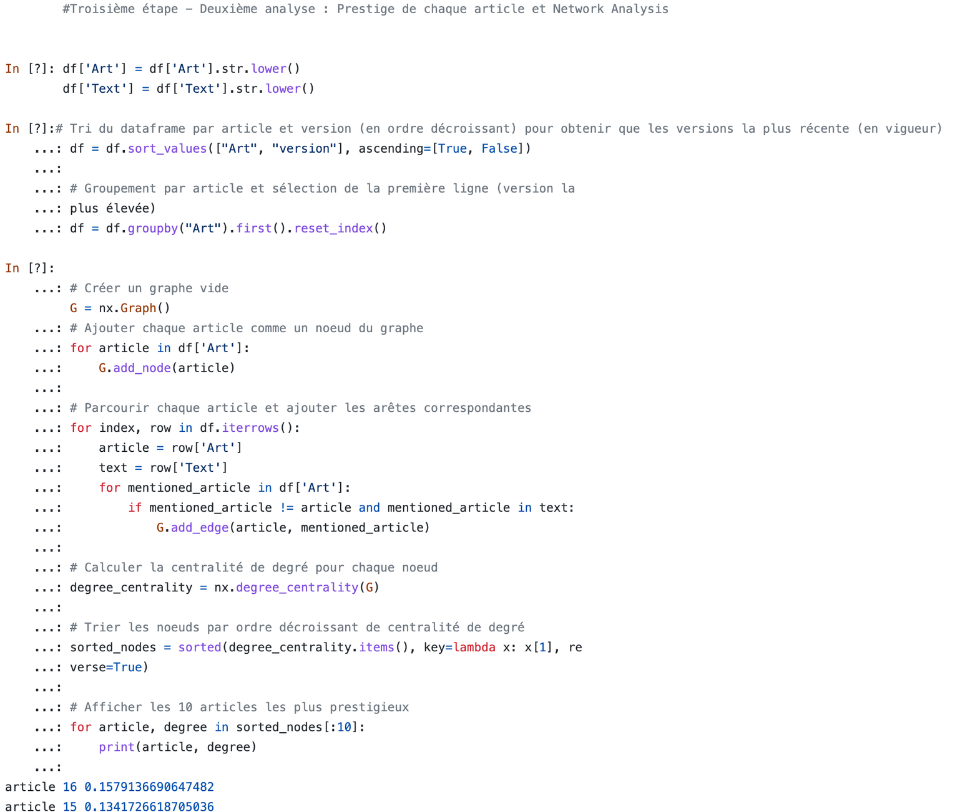

/10
STEP 3 : Prestige & Network Analysis
The Python Code

Slide 12

/11
STEP 3 : Prestige & Network Analysis
Article 6
Article 8
Article 39
Article 158
Article 108
Les Analystes du CGI
The Network Analysis

Slide 13

/12
Analysis of some "prestigious" articles (the most frequently quoted) of the CGI

Slide 14
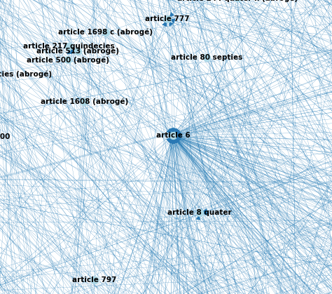
/13
Article 6
Article relating to the taxation of taxpayers in family situations (joint taxation of spouses and exceptions, what taxation of children's income, what possibility of attachment to the tax household, etc.) ;
Article cited for example by article 156 which provides that "Income tax is established according to the total amount of annual net income available to each tax household. This net income is determined with regard to the property and capital owned by the members of the tax household designated in 1 and 3 of article 6" ;
The frequent reference to this article is quite logical since it allows to define the tax household to which the articles establishing the different taxes refer.

Slide 15
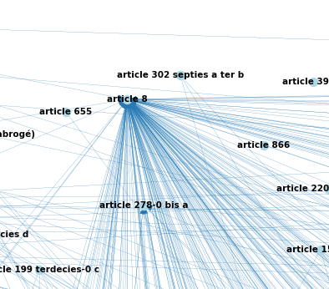
/14
Article 8
Article focusing on the taxation of tax transparent companies ;
Article quoted, for example, by article 206, which provides for the optional taxation of certain companies governed by article 8 ;
The frequency with which this article is quoted is again logical, as Article 8 companies are subject to a rather special tax regime, and the articles governing this special regime often refer to Article 8 to materialize their scope.

Slide 16
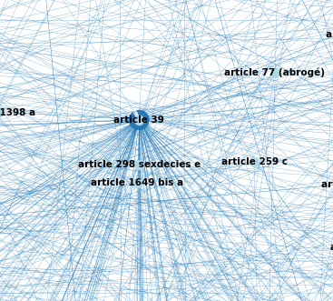
/15
Article 39
Article describing the methods of establishing the net profit in the category of industrial and commercial profits, in particular with regard to the expenses admitted in deduction ;
Among the articles referring to Article 39 we find logically Article 209 which determines the profits subject to corporate income tax ;
The "prestige" of article 39 is again logical in that it is a major legal basis for the taxation of BICs, but also for its point 12 which gives a definition very often used by other articles on the links of dependence between two companies.

Slide 17
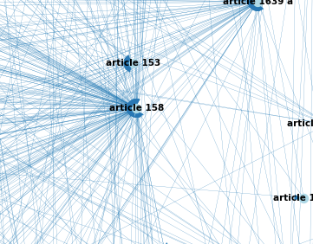
/16
Article 158
Article 158 specifies the way in which the net income of the various tax categories is included in the global net income for the calculation of the personal income tax ;
Article 158 is, for example, cited by Article 243 ter, which requires certain evidence from persons paying income from movable property subject to the 40% deduction provided by Article 158 ;
The importance of Article 158 is not surprising in that it links all categorical income and retirement with different arrangements to form the overall net income subject to personal income tax.

Slide 18
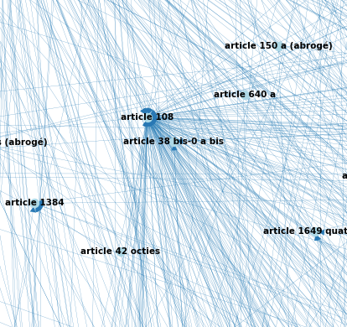
/17
Article 108
This article introduces articles 109 to 117 which deal with income distributed by companies subject to corporate income tax ;
This article is, for example, cited by Article 187, which provides, among other things, for a withholding tax of 75% on income distributed to persons located in non-cooperative states or territories ;
As article 108 introduces the whole regime of distributed income, which is the subject of a fairly large number of articles, its presence in the most frequently cited articles is not surprising.

Slide 19
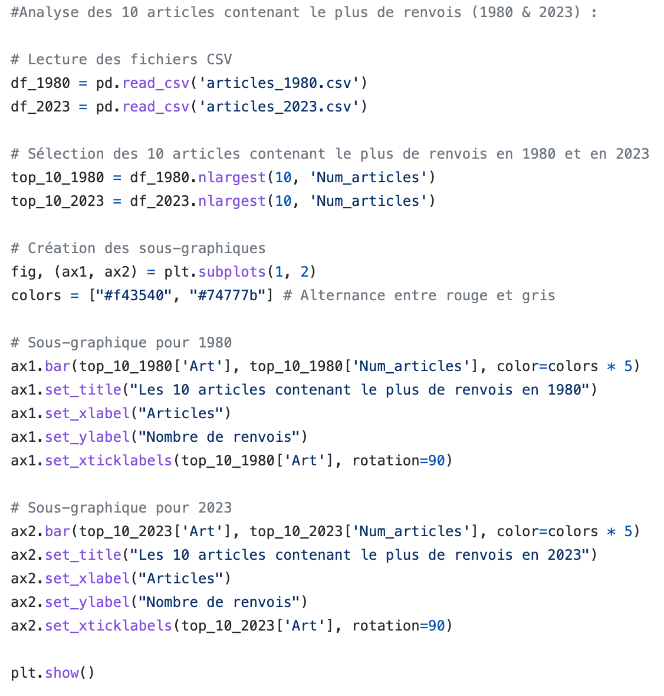
/18
STEP 4 : Some extra analysis
Les Analystes du CGI
The Python Code

Slide 20
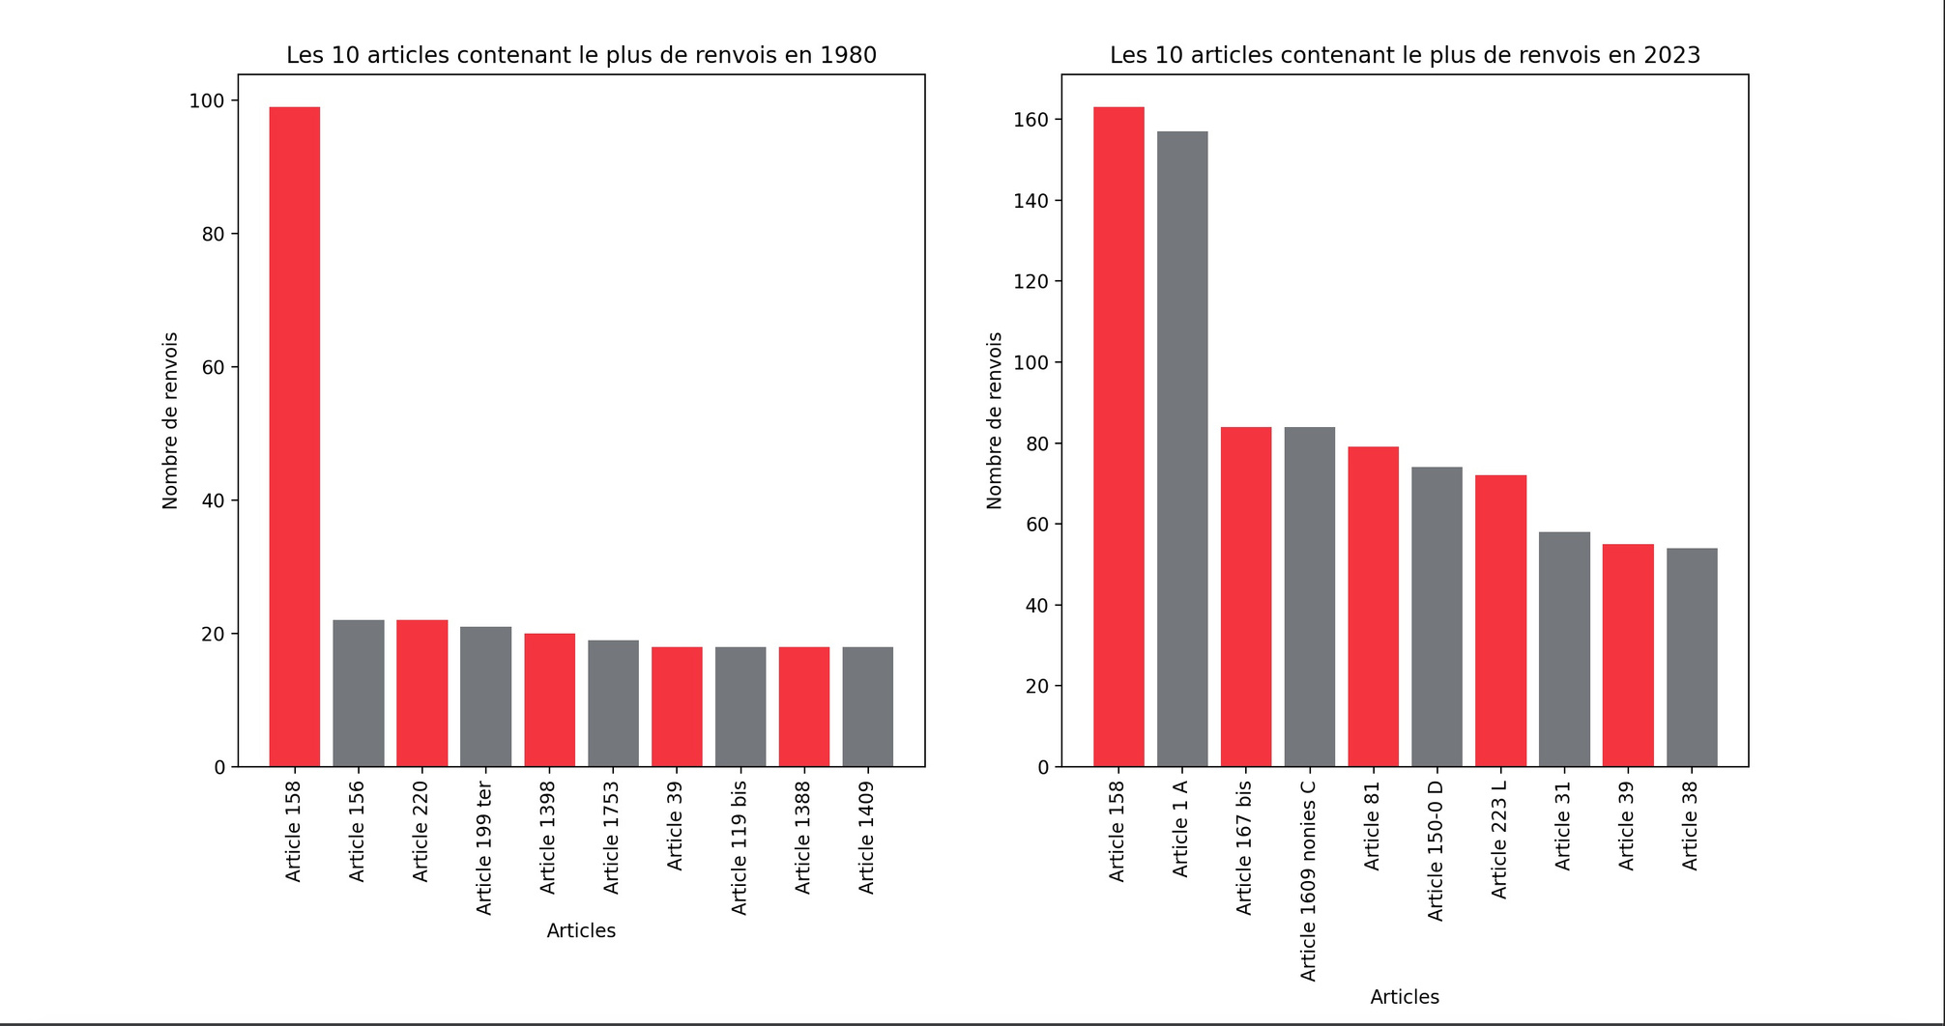
Articles with the most references to other articles
(in 1980 and today)
/19
STEP 4 : Some extra analysis

Slide 21
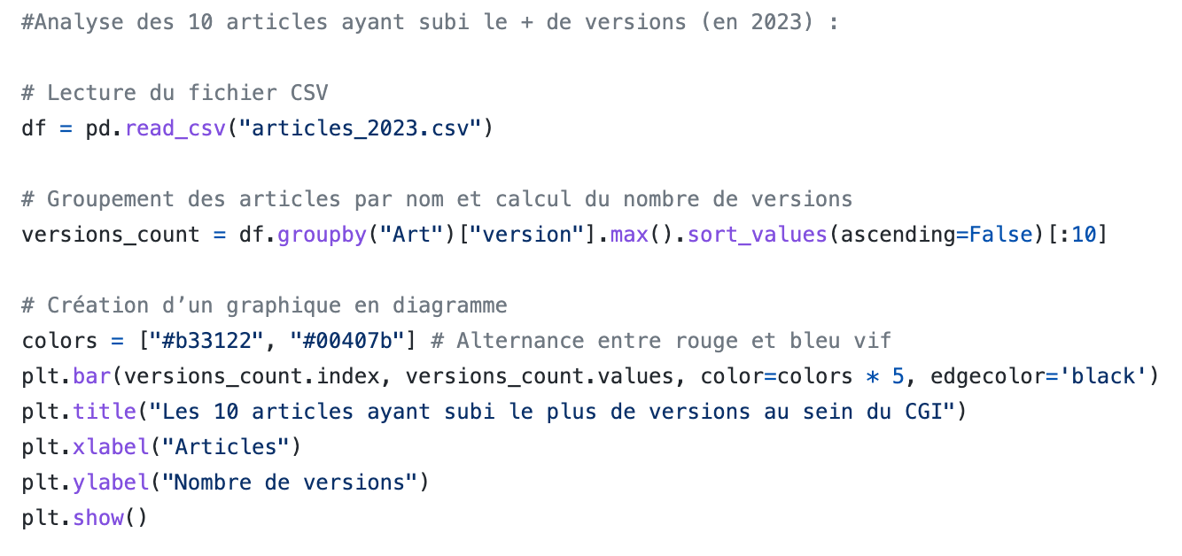
/20
STEP 4 : Some extra analysis
Les Analystes du CGI
The Python Code

Slide 22
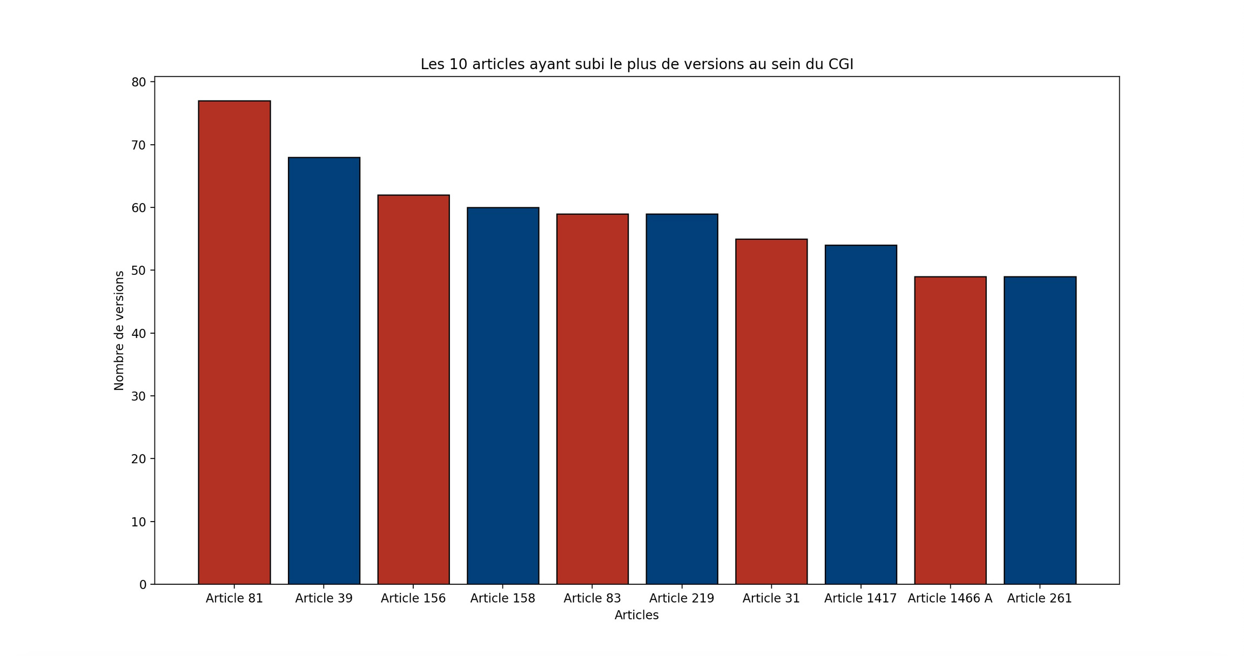
The 10 most revised articles of the CGI
/21
STEP 4 : Some extra analysis

Slide 23

Thank you !

